Slide 1

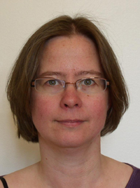
Discrimination and loss of complexity in an indigenous language: Possessive suffixes in North Saami
Laura A. Janda
Lene Antonsen

Slide 2
What do YOU want to hear most about?
Linguistic details of an ongoing change
Sociolinguistic situation of North Saami language
Cultural and artistic context of the North Saami language
Political situation facing the Saamis

Slide 3
About the author: Máret Ánne Sara
Born 1983, Kautokeino
Visual artist, featured at Documenta 14
Sister of Jovsset Ánte Sara, on trial for refusal to slaughter his reindeer
Family featured in NRK minute-by-minute week-long documentary of reindeer migration in April 2017
http://www.maretannesara.com/

Slide 4
Overview
Facts about the Saamis
More about the language
Challenges, etc.

Slide 5
What do YOU associate with the Saami People?

Slide 6
Facts about the Saamis
Reindeer
Skis
Joik
Colorful Clothing
Far North
Exotic Language

Slide 7
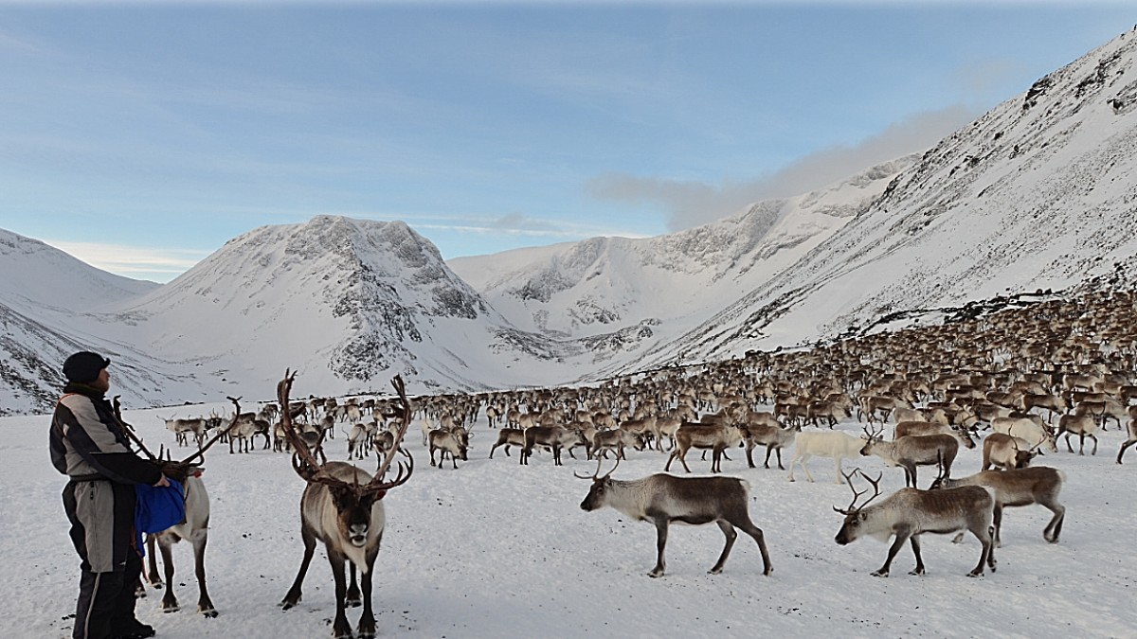
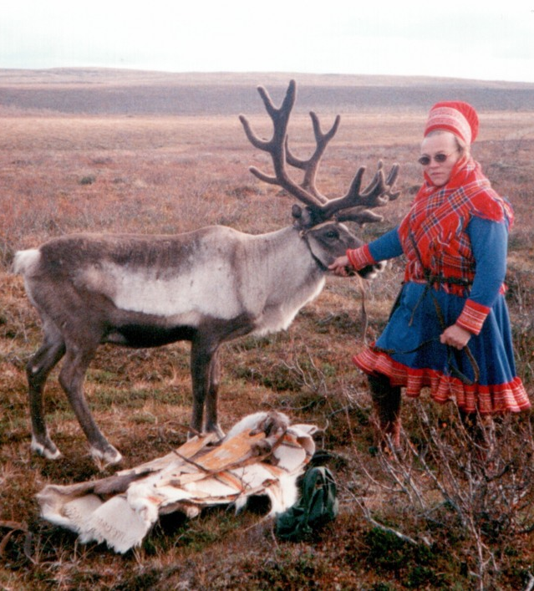
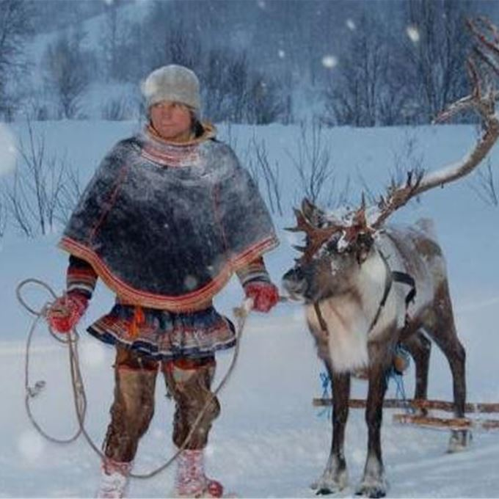
Reindeer: bohccot
Reindeer herding is a traditional way of life
Involves semi-annual migrations
Saamis also work in fishing and farming
Herding reindeer remains a popular choice for young Saamis
Reindeer herding can be studied at the Saami University of Applied Sciences in Kautokeino

Slide 8
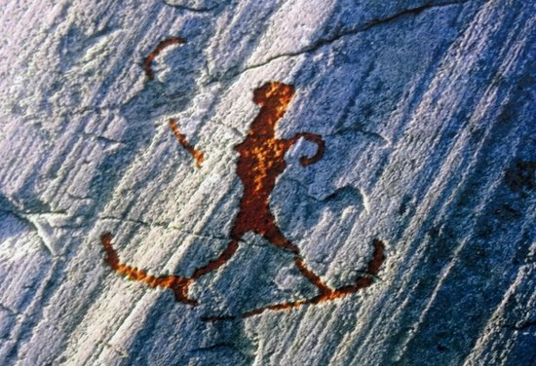
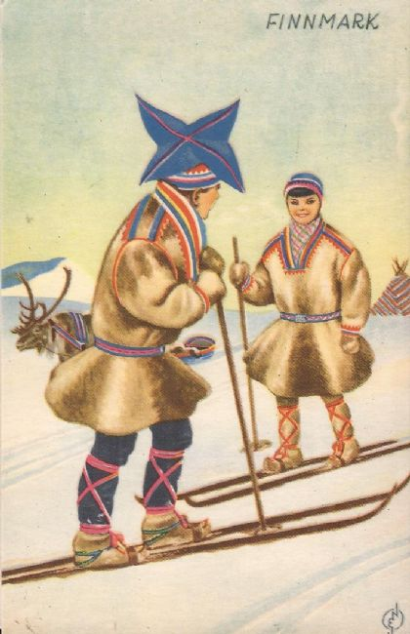
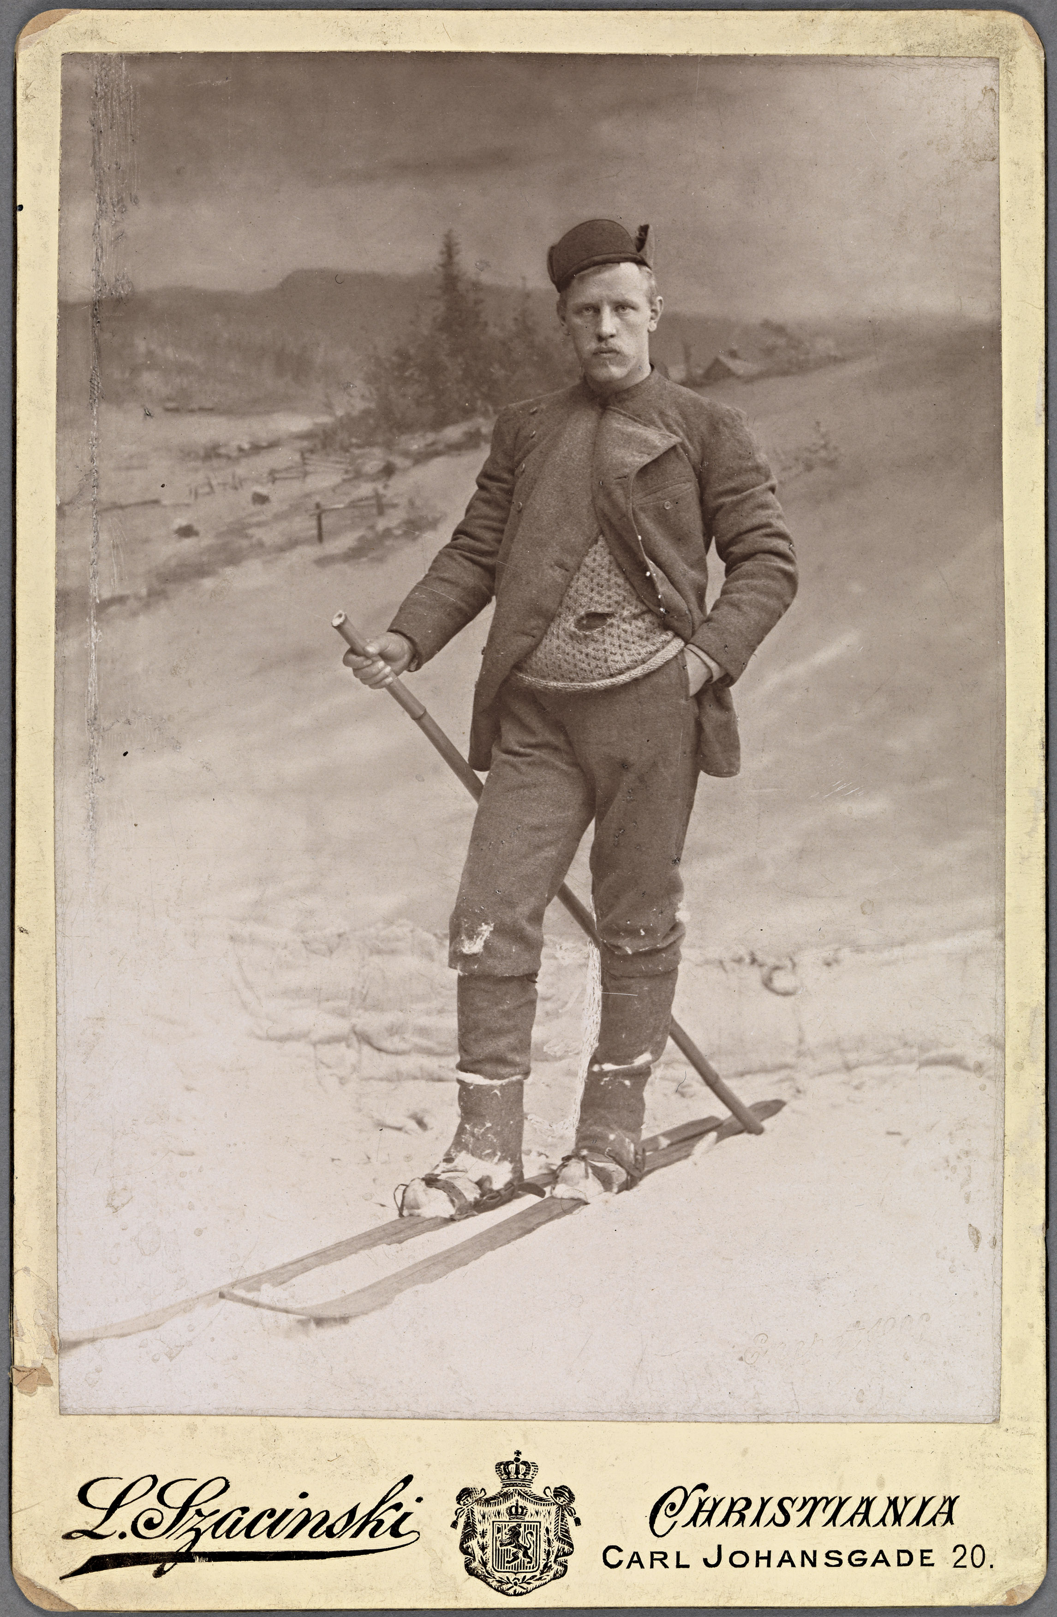
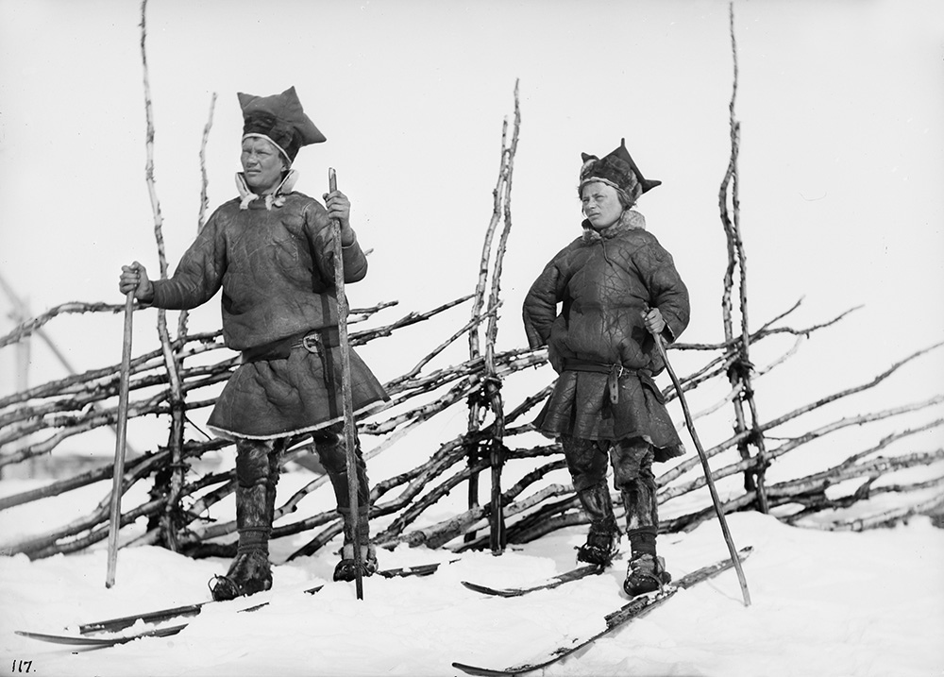
Skis: sabehat
Saamis are believed to have invented skis
Petroglyphs show Saamis on skis approx 5000 years ago
Norway’s famous Arctic explorer, Fritjof Nansen (1861-1930) had Saami skiers on his expeditions and popularized the sport

Slide 9
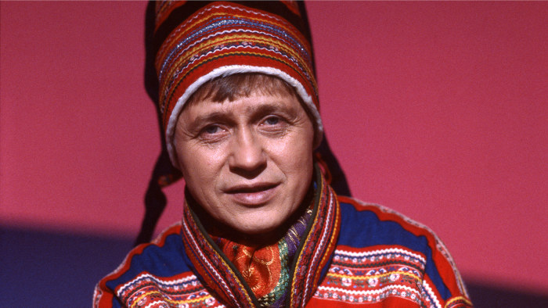
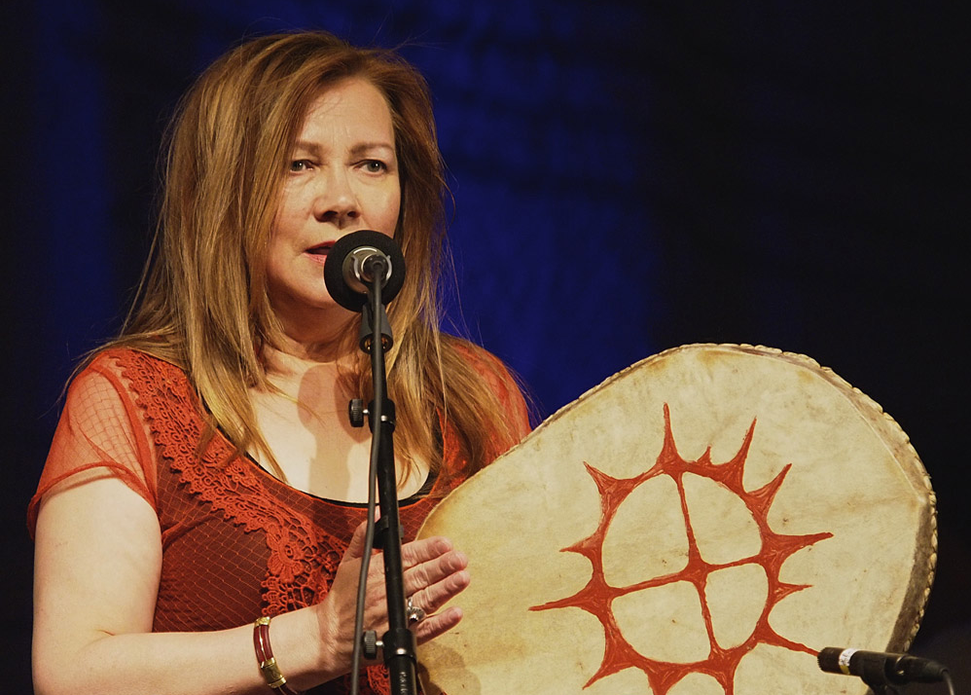
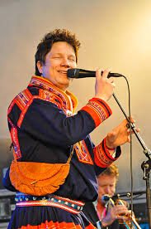
Joik: luohti, juoigat
Traditional way of singing among the Saami people
The most famous modern joiker was Nils-Aslak Valkeapää (aka Áillohaš, 1943-2001), who used joik to prove that the Saami are an indigenous people at the meeting of the World Council of Indigenous Peoples in Canada in 1975
The most famous living joiker is Mari Boine

Slide 10
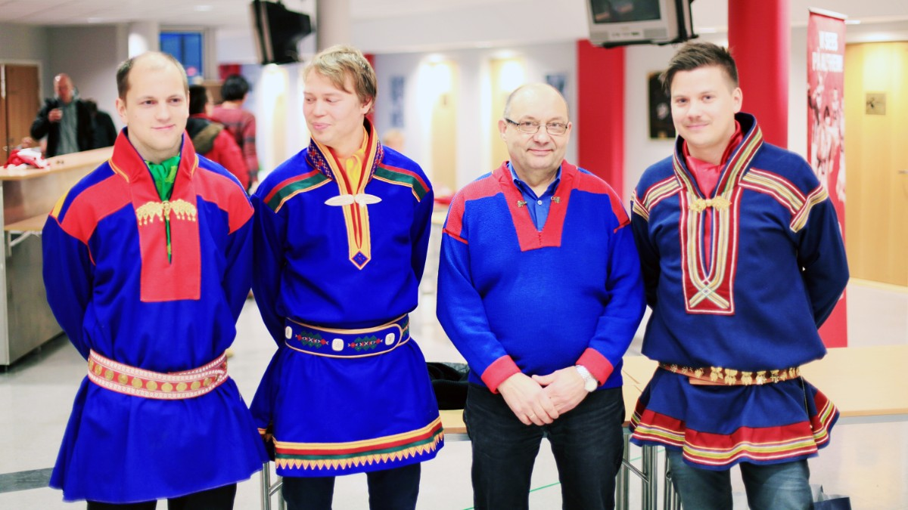
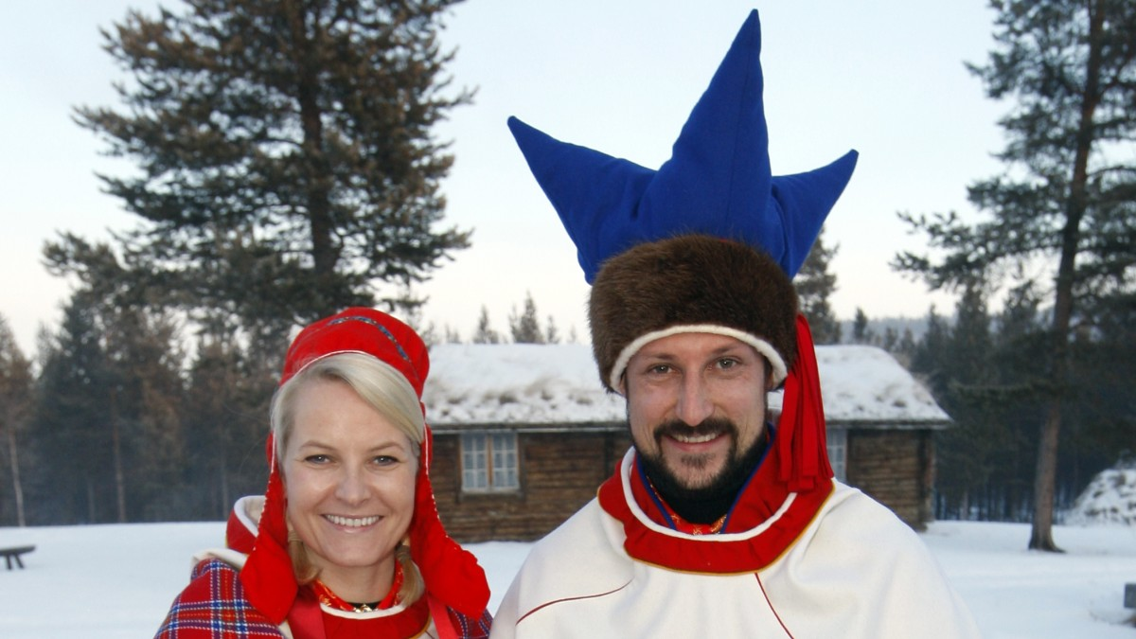
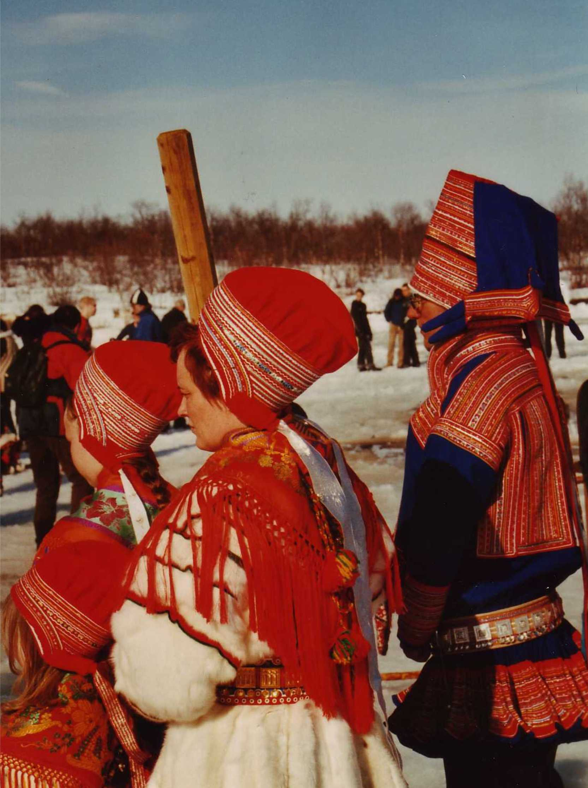
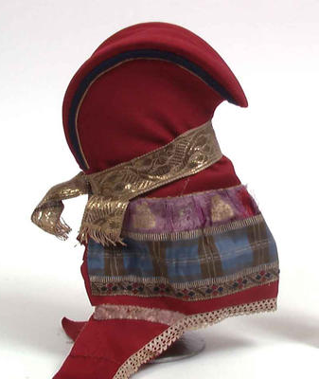
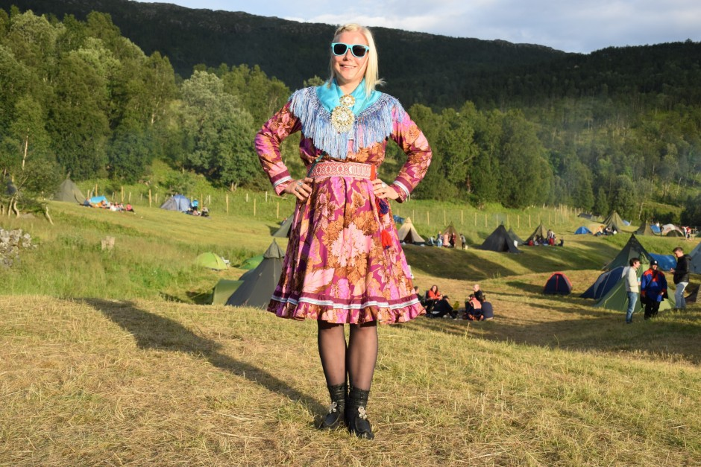
Colorful Clothing: biktasat
A woolen or fur cloak, called gákti, can be brightly colored, and both decorations and accessories (especially hats) vary from one region to another
Modern Saamis experiment with traditional themes

Slide 11
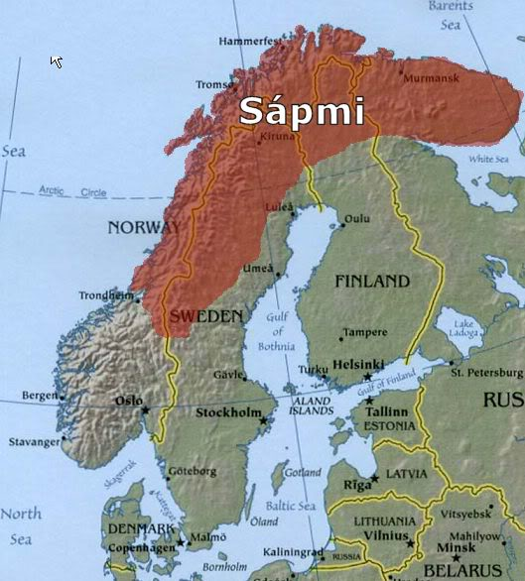
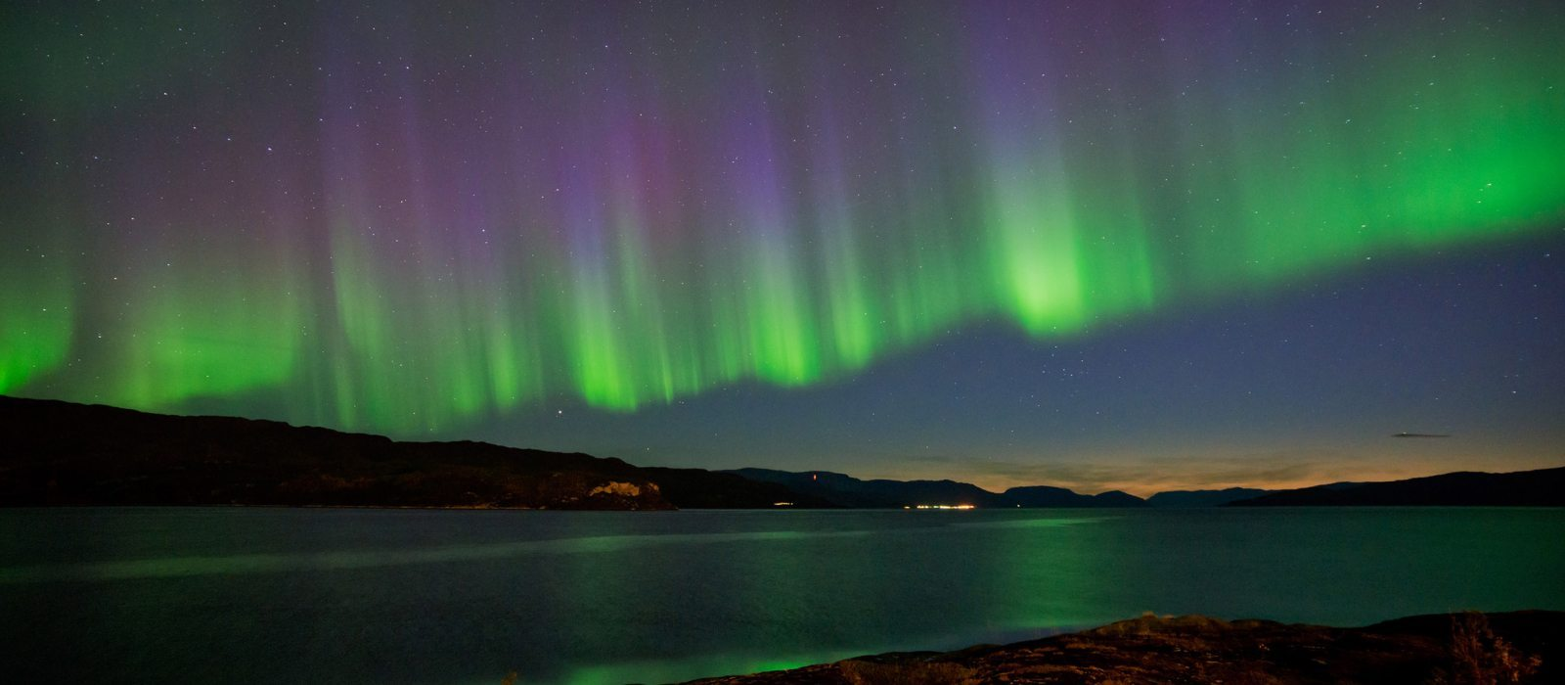
Far North: davvin
The Saami lands (called Sápmi) are mostly above the Arctic Circle in the territories of Norway, Sweden, Finland, and Russia
This is the land of both northern lights (in winter) and midnight sun (in summer)

Slide 12
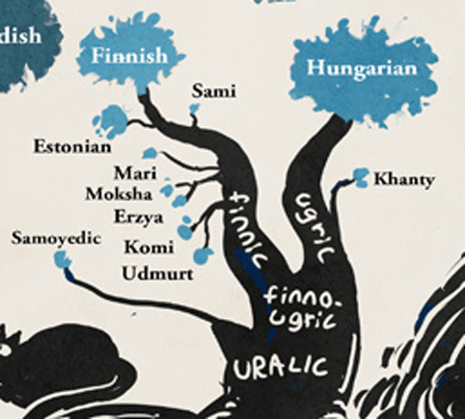
Exotic Language: eksohtalaš giella
Saami forms its own branch on the Finnic trunk of the Uralic tree
Not comprehensible to speakers of any other Uralic languages
North Saami is the only minority language of Europe that is in a contact situation with majority languages from two different families: Indo-European (Norwegian & Swedish), and Uralic (Finnish)

Slide 13
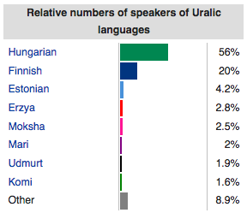
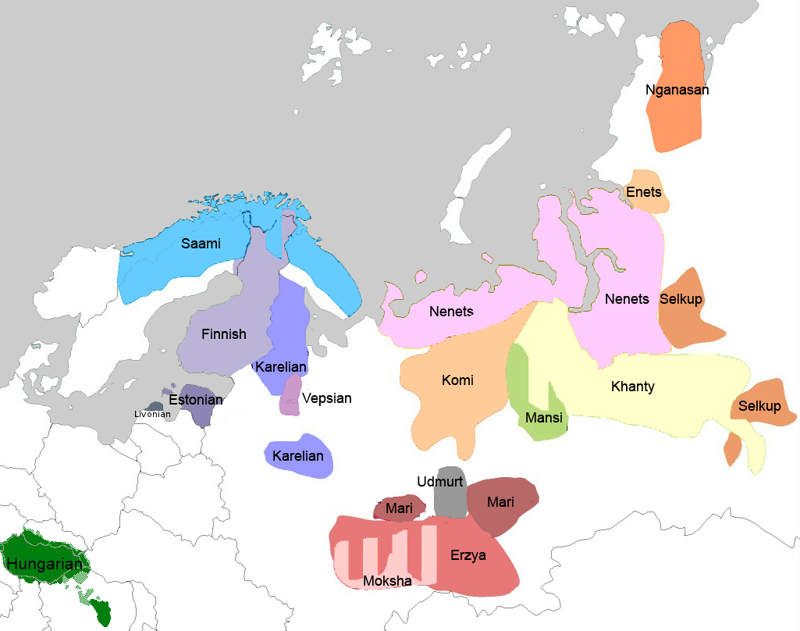
In other words, although Saami covers a big territory, it is less than 1% of the Uralic family

Slide 14
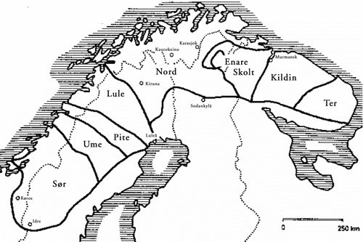
Exotic Language: eksohtalaš giella
N. Saami
There are 9-10 Saami languages
The largest is North Saami, with about 20,000 speakers
North Saami has a very complex system of morphophonemic alternations (literally hundreds of them) that depend on the number of syllables in a word, but these alternations are entirely regular
North Saami expresses dual in verbs, but not in nouns
There are no words for ‘no’ and ‘yes’ or ‘maybe’ in North Saami – these are expressed with verbs
‘Wetness’ can be expressed by using singular vs. plural with non-count nouns

Slide 15
Exotic Language: eksohtalaš giella
‘reindeer’ > NomPl, ‘ending’ > GenSg, ‘entryway’ > LocSg
boazu | geažus | feaskkir
bohccot | gehčosa | feaskáris
diphthong reduction
consonant alternation
vowel alternation
case/number ending

Slide 16
Facts about the Saamis
Fun Facts
Reindeer
Skis
Joik
Colorful Clothing
Far North
Exotic Language

Slide 17
Facts about the Saamis
Fun Facts
Reindeer
Skis
Joik
Colorful Clothing
Far North
Exotic Language
Not So Fun Facts
Threats to Reindeer
Residential Schools
Racism
Suicide
Climate Change
Language Endangerment

Slide 18
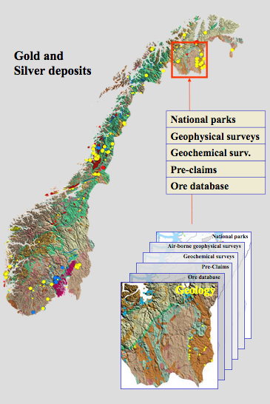
Threats to Reindeer: áitagat boazodollui
Reindeer need A LOT of space
Mining, on-shore windmill parks, high-tension electric wires, railroads, development threaten the grazing lands
www.prospecting.no provides one-stop interactive “shopping” for mining companies
Statnett is planning a 420kw electric line, and transported the building materials before the trial that the Saamis have brought even began…

Slide 19
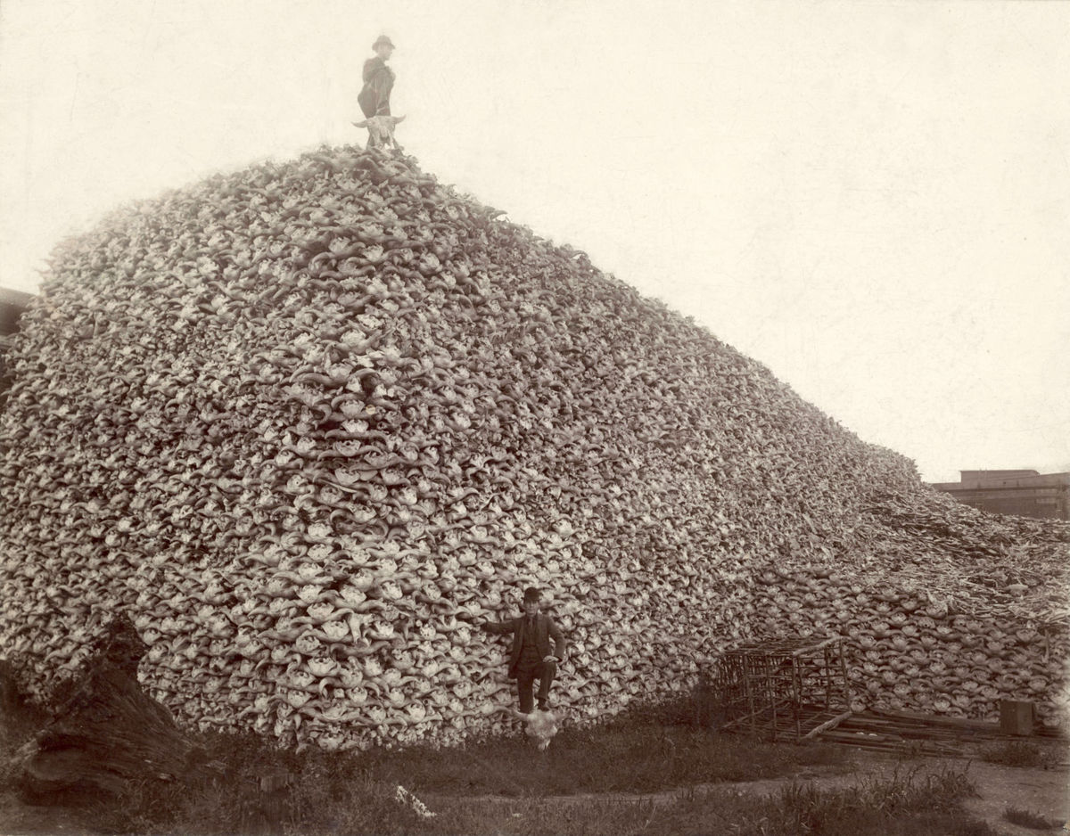
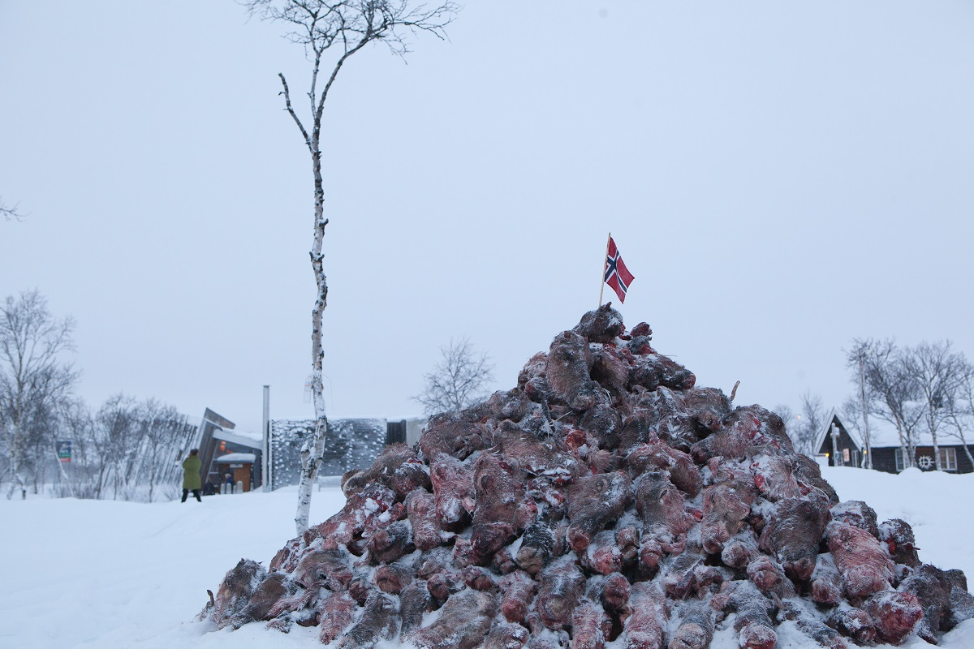
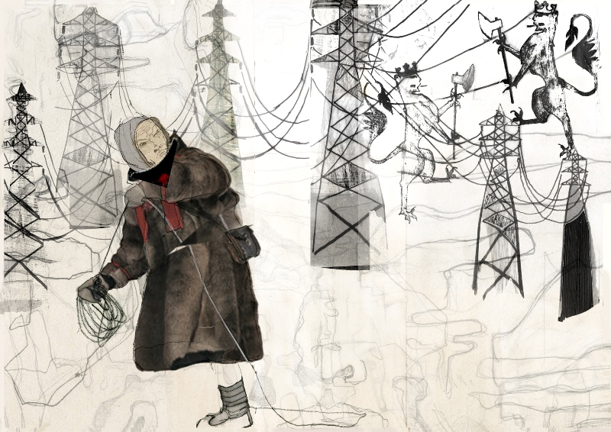
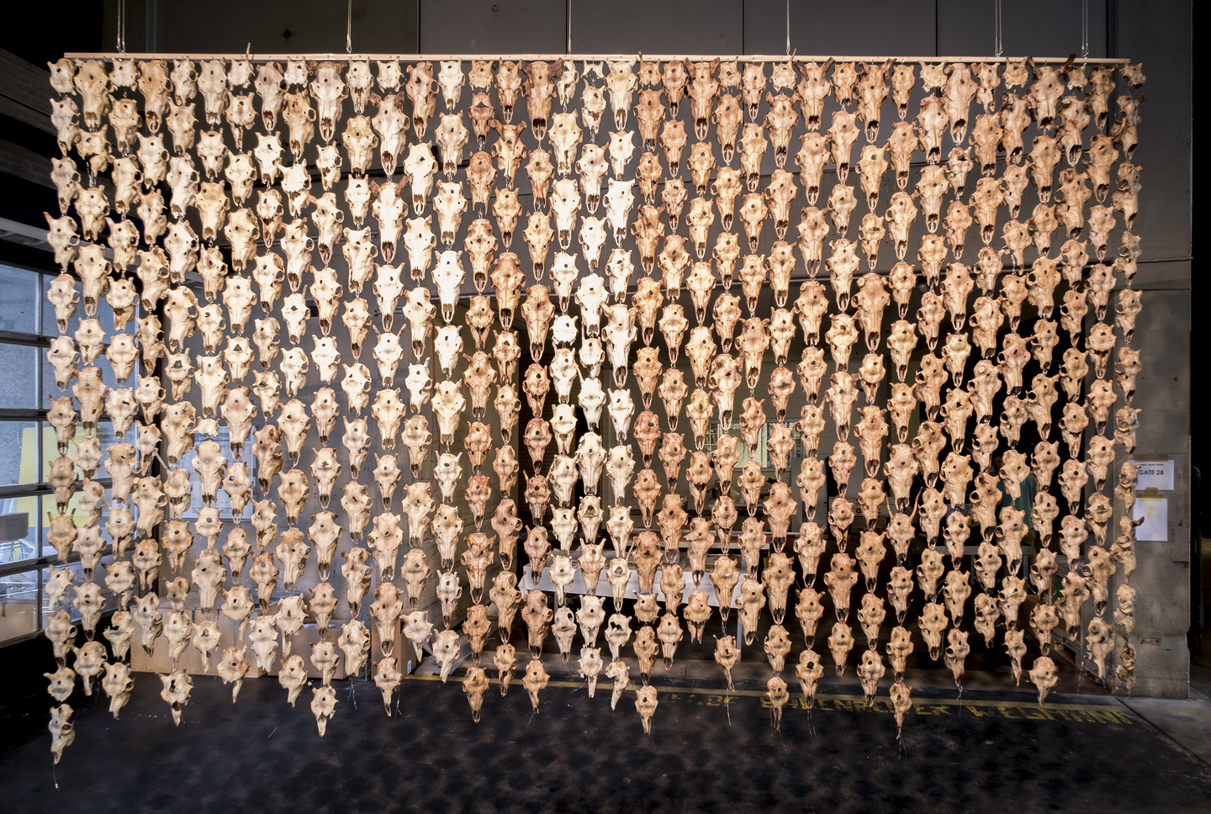
Threats to Reindeer: áitagat boazodollui
Norwegian government is forcing herders to slaughter their animals, claiming that the reindeer are a threat to the environment
Saamis believe they are being driven off their lands, just as Europeans drove Native Americans off by killing off the buffalo
Notes:
Also: disease, train accidents, windmills, electric lines…

Slide 20
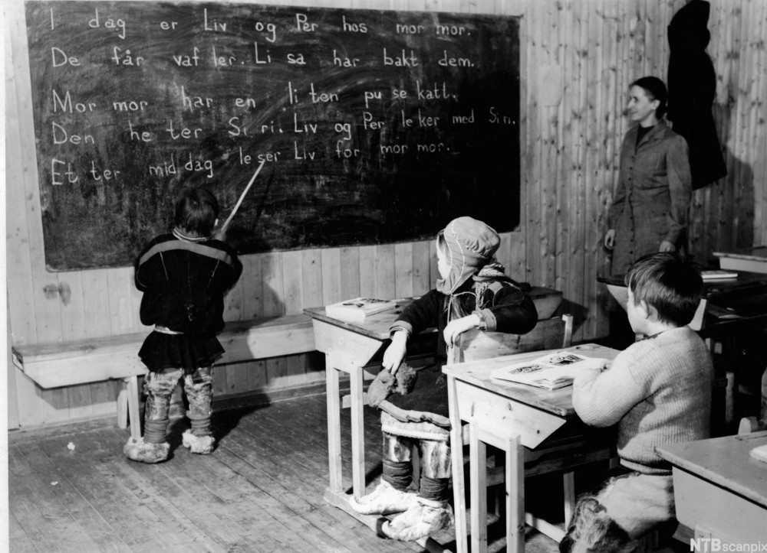
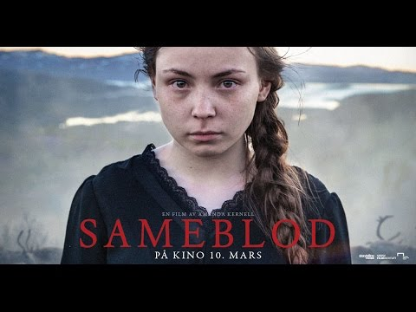
Residential Schools: skuvlainternáhtat
In much of the 20th century, Saami children were forcibly removed from their families and put in schools where they were not allowed to speak their language
This trauma is shared by virtually all Saamis age 60+

Slide 21
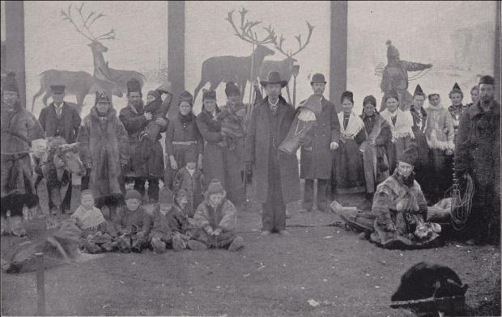
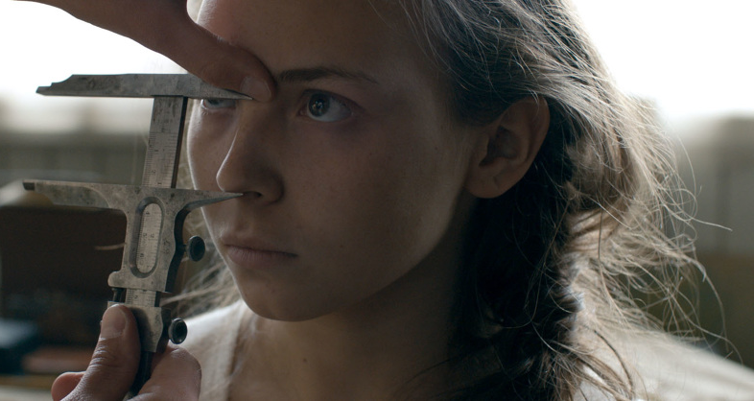
Racism: nállevealaheapmi
Saamis were displayed in zoos and exhibitions until the end of WWII and were the object of “scientific racism”
Stigmatism continues

Slide 22
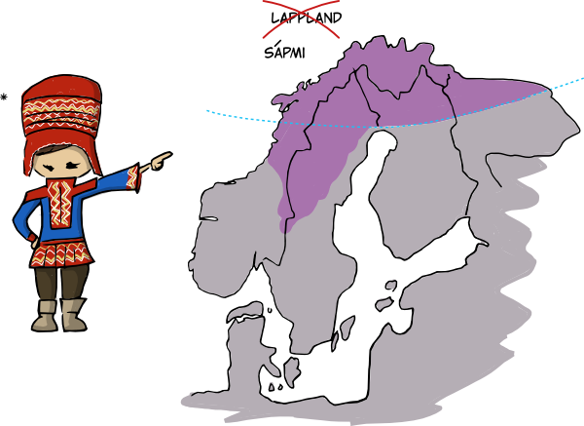
Racism: nállevealaheapmi
“Lapp” and “Finn” (in Norwegian) are the equivalent of the “n-word”
The northernmost province of Norway, where many Saamis live, is called “Finnmark”

Slide 23
Please remember this for later…
North Saami can be understood as comprising two regions:
East = North Saami spoken in Finland
West = North Saami spoken in Norway + Sweden
Norway
Finland
Sweden

Slide 24
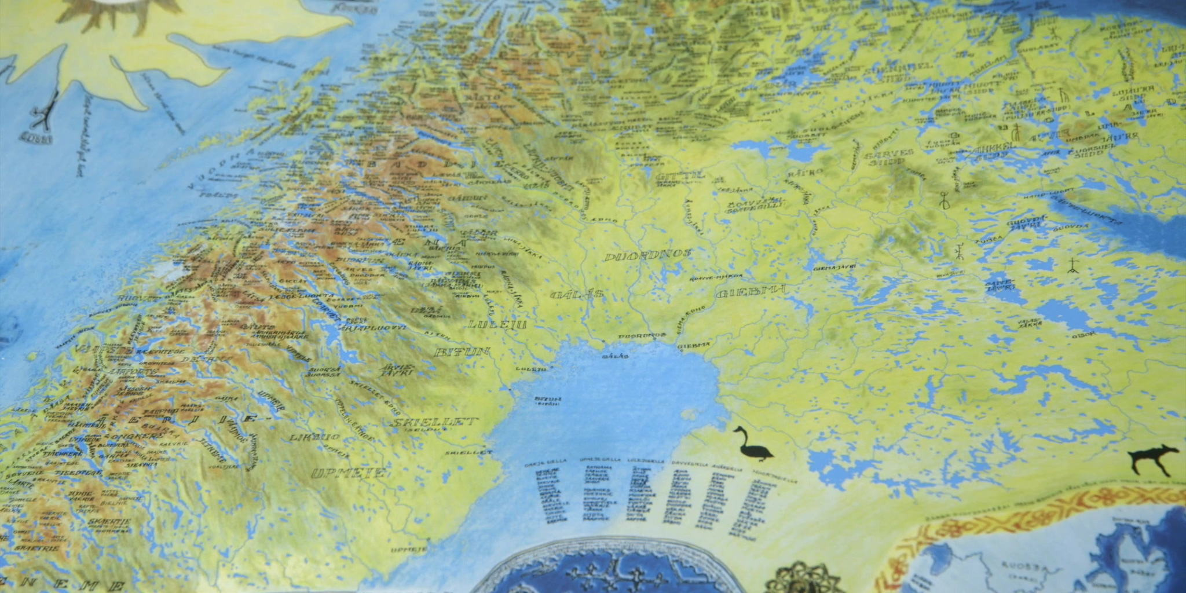
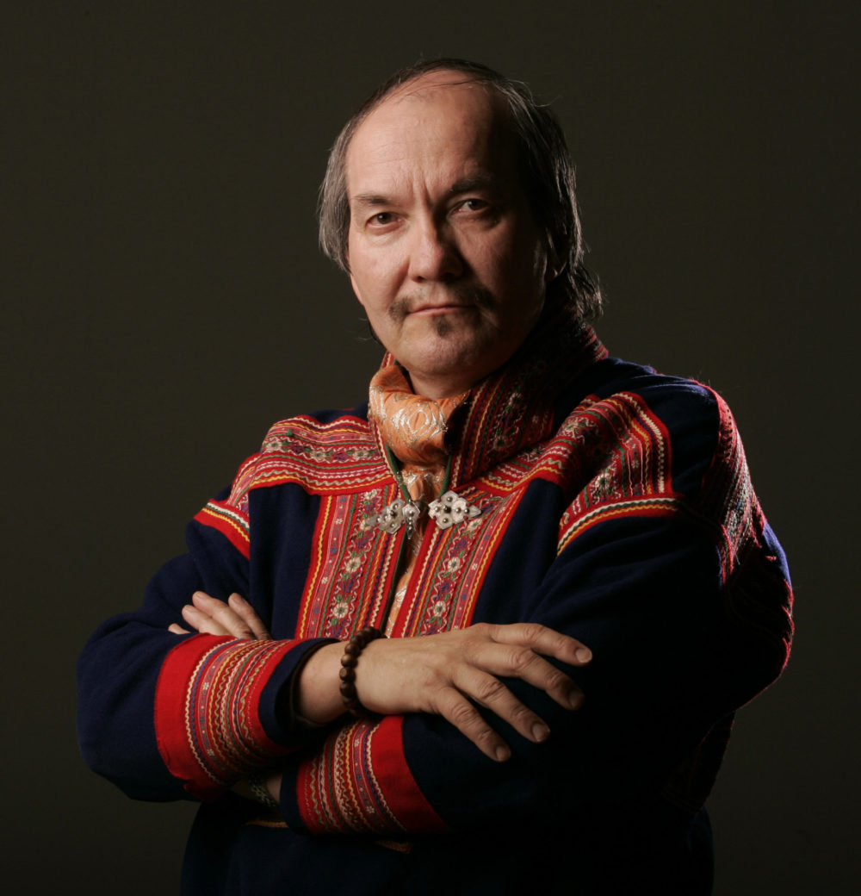
Racism: nállevealaheapmi
Saamis were literally erased from official maps
In 1975 Hans Ragnar Mathisen made a map of Saami lands using original Saami toponyms

Slide 25

Suicide: iešsorbmen
Saamis, men especially, are at higher risk of suicide
Saamis also suffer other social ills at higher rates than majority populations, such as: alcoholism, teenage pregnancy, etc.

Slide 26
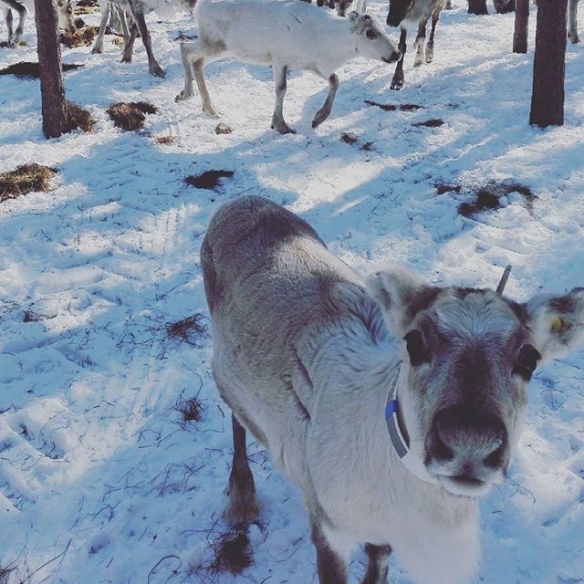
Global Warming: globála liegganeapmi
Climate change is faster and more severe in the Arctic than in most of the rest of the world. The Arctic is warming at a rate of almost twice the global average.
This is another threat to reindeer herding and other traditional ways of life

Slide 27
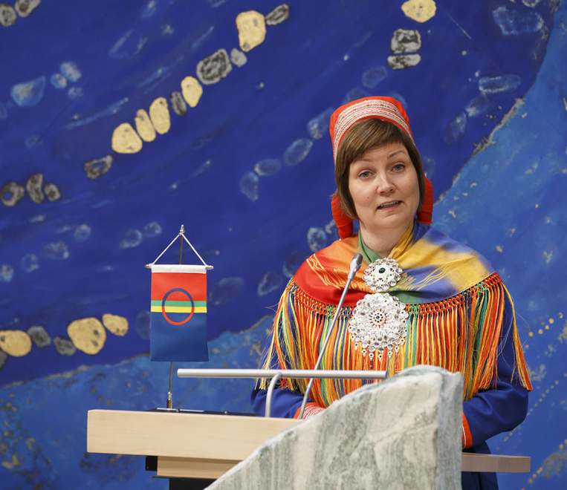
Threatened Language: áitatvuološ giella
Sociolinguistic landscape of North Saami today is highly heterogeneous: there are native speakers; people who heard or spoke North Saami as children, shifted to a majority language during school years, later reacquired the language; and people who learned the language as adults.
Most speakers of North Saami have not received education in the language and are literate only in a majority language.

Slide 28
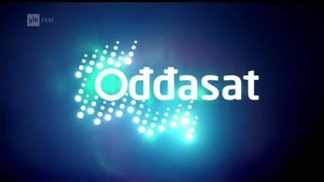
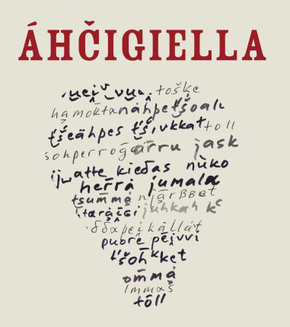
Threatened Language: áitatvuološ giella
Trudgill (2002) and McWhorter (2007, 2011) argue that the ‘normal’ state of language is highly complex, and that languages that are most exposed to contact and adult learners show evidence of simplification.
On Trudgill’s (2011: 147) six-point scale of communities, where ‘1’ is the type of language that tends most toward complexification, North Saami would rank as a ‘4’, with a small size, loose network and high level of contact.

Slide 29
An ongoing language change in North Saami: NPx is being replaced by ReflN
ReflN = Reflexive genitive pronoun + Noun
Two examples from Elle Márjá Vars’ novel Kátjá
NPx (possessive suffix, HIGH morphological complexity):
(1a) Kátjá... ollii latnjasis
Kátjá.nom reach.ind.pret.3s room.ill.sg.px.3s
‘Kátjá... got to her room’
ReflN (analytic construction with reflexive genitive pronoun):
(1b) Kátjá... ollii iežas latnjii
Kátjá.nom reach.ind.pret.3s refl.gen.3s room.ill.sg
‘Kátjá... got to her room’
NPx = Noun + Possessive suffix

Slide 30
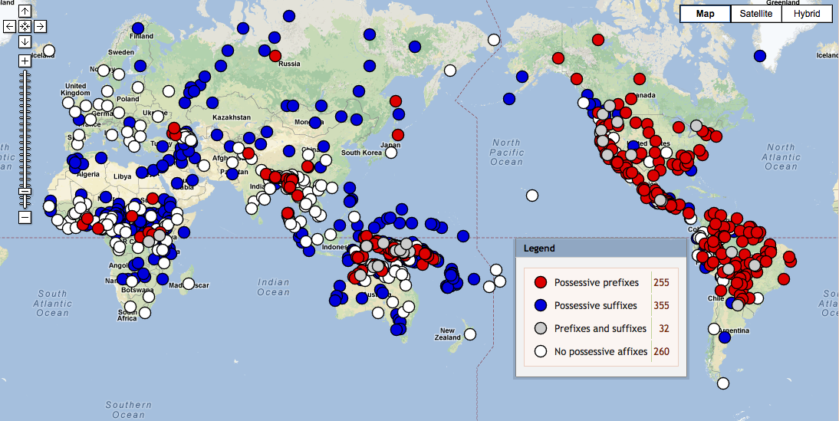
WALS Feature 57a: Possessive affixes
North Saami

Slide 31
ReflN components = 9 + 10 items otherwise needed reflexive Genitive pronoun + noun inflection
Paradigm of reflexive genitive pronoun |  | Paradigm of noun guoibmi “partner”
1sg | ieža-n | nom.sg | guoibmi
2sg | ieža-t | gen.sg=acc.sg | guoimmi
3sg | ieža-s | ill.sg | guoibmá-i
1du | ieža-me | loc.sg | guoimmi-s
2du | ieža-de | com.sg=loc.pl | guimmi-in
3du | ieža-ska | nom.pl | guoimmi-t
1pl | ieža-met | gen.pl=acc.pl | guimmi-id
2pl | ieža-det | ill.pl | guimmi-ide
3pl | ieža-set | com.pl | guimmi-iguin
 |  | ess | guoibmi-n

Slide 32
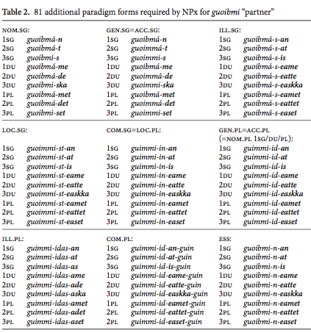
Use of the NPx requires mastery of 81 additional unique forms, or a noun paradigm with 130 slots (instead of just 13)
Imagine that you are reclaiming or learning North Saami as an adult
Which possessive construction would you choose?

Slide 33
Morphological complexity in the face of intense contact
NPx is much more morphologically complex than ReflN
North Saami is under intense pressure from both Germanic (Norwegian and Swedish) and Finnish
Many North Saami speakers have reclaimed the language as adults
Language contact and 2nd language learners can lead to morphological simplification (Trudgill 2002, McWhorter 2007, Bentz & Winter 2013)
In this situation, there may be an advantage for the morphologically simpler form: ReflN

Slide 34
An example of an S-curve (cited by Blythe & Croft 2012)
The S-curve

Slide 35
The S-curve in our Data
Our S-curve is from this data
Literary texts: 530,000 words, three age groups, two geographic regions
2,272 examples, full analysis by hand
The New Testament (1998): 136,522 words
1,530 examples, full analysis by hand
Newspapers: 10M words from three newspapers (1997-2011)
29,964 examples of words with frequency ≥5, partial automatic analysis, a lot of cleaning by hand
Total: 33,633 examples

Slide 36
Author | Year of Birth | Geography | Number of words | # NPx exx | # ReflN exx | Proportion ReflN
A. Larsen | 1870 | West | 10 150 | 151 | 12 | 0.07
J. Turi | 1895 | West | 48 559 | 89 | 24 | 0.21
K. N. Turi | 1895 | West | 23 400 | 43 | 3 | 0.07
H. A. Guttorm | 1907 | East | 28 500 | 259 | 9 | 0.03
M. Bongo | 1923 | West | 8060 | 16 | 1 | 0.06
A. O. Eira | 1927 | West | 14 600 | 35 | 3 | 0.08
J.-Á. Vest | 1948 | East | 151 592 | 512 | 378 | 0.42
K. Paltto | 1947 | East | 81 700 | 145 | 51 | 0.26
E. M. Vars | 1957 | West | 92 500 | 187 | 156 | 0.45
J. M. Mienna | 1972 | West | 49 100 | 20 | 68 | 0.77
M. Á. Sara | 1983 | West | 29 800 | 57 | 64 | 0.53
Old
Mid
Young

Slide 37

Mid Generation speakers were removed from their L1 environment during their school years, creating a sociolinguistic situation in which morphological complexity is disadvantaged
Author | Year of Birth | Geography | Number of words | # NPx exx | # ReflN exx | Proportion ReflN
A. Larsen | 1870 | West | 10 150 | 151 | 12 | 0.07
J. Turi | 1895 | West | 48 559 | 89 | 24 | 0.21
K. N. Turi | 1895 | West | 23 400 | 43 | 3 | 0.07
H. A. Guttorm | 1907 | East | 28 500 | 259 | 9 | 0.03
M. Bongo | 1923 | West | 8060 | 16 | 1 | 0.06
A. O. Eira | 1927 | West | 14 600 | 35 | 3 | 0.08
J.-Á. Vest | 1948 | East | 151 592 | 512 | 378 | 0.42
K. Paltto | 1947 | East | 81 700 | 145 | 51 | 0.26
E. M. Vars | 1957 | West | 92 500 | 187 | 156 | 0.45
J. M. Mienna | 1972 | West | 49 100 | 20 | 68 | 0.77
M. Á. Sara | 1983 | West | 29 800 | 57 | 64 | 0.53
Old
Mid
Young

Slide 38
Author | Year of Birth | Geography | Number of words | # NPx exx | # ReflN exx | Proportion ReflN
A. Larsen | 1870 | West | 10 150 | 151 | 12 | 0.07
J. Turi | 1895 | West | 48 559 | 89 | 24 | 0.21
K. N. Turi | 1895 | West | 23 400 | 43 | 3 | 0.07
H. A. Guttorm | 1907 | East | 28 500 | 259 | 9 | 0.03
M. Bongo | 1923 | West | 8060 | 16 | 1 | 0.06
A. O. Eira | 1927 | West | 14 600 | 35 | 3 | 0.08
J.-Á. Vest | 1948 | East | 151 592 | 512 | 378 | 0.42
K. Paltto | 1947 | East | 81 700 | 145 | 51 | 0.26
E. M. Vars | 1957 | West | 92 500 | 187 | 156 | 0.45
J. M. Mienna | 1972 | West | 49 100 | 20 | 68 | 0.77
M. Á. Sara | 1983 | West | 29 800 | 57 | 64 | 0.53
Old
Mid
Young

Slide 39
Our S-curve: longitudinal data from literary texts The timing of the change aligns with discriminatory policies
Young
Mid
Old

Slide 40
Our S-curve: longitudinal data from literary texts The timing of the change aligns with discriminatory policies
But:
how important is Generation in relation to other factors?
Young
Mid
Old

Slide 41
Statistical analysis: Factors and levels
Possessum (the one that is possessed; PM):
Case: Nom, Acc, Gen, Ill, Com, Loc, Ess
Number: Sg, Pl
Semantic Class: Kin, Human, Body...
Possessor (the one that possesses; PR):
Case: Nom/Verb, Acc, Gen, Ill, Loc
Person and Number: 1Sg, 2Sg, 3Sg, 1Du, 2Du, 3Du, 1Pl, 2Pl, 3Pl
Semantic Class: Human, Animal, Nature...
Generation: Old vs. Mid vs. Young
Geography: East vs. West

Slide 42
Five factors turned out to be significant Statistical analysis: Factors and levels
Possessum (the one that is possessed; PM):
Case: Nom, Acc, Gen, Ill, Com, Loc, Ess
Number: Sg, Pl
Semantic Class: Kin, Human, Body...
Possessor (the one that possesses; PR):
Case: Nom/Verb, Acc, Gen, Ill, Loc
Person and Number: 1Sg, 2Sg, 3Sg, 1Du, 2Du, 3Du, 1Pl, 2Pl, 3Pl
Semantic Class: Human, Animal, Nature...
Generation: Old vs. Mid vs. Young
Geography: East vs. West
PMCase
PMClass
PRCase
Generation
Geography

Slide 44
We ran this analysis with just the authors’ names instead of Generation and Geography and got the exact same results. It is possible to sort authors according to both factors based only on their use of NPx vs. ReflN.

Slide 45
Measure of Variable Importance

Slide 46
Let’s look at PMClass, PMCase, and PRCase in a little more detail
Measure of Variable Importance

Slide 47
Old
Mid
Young
Semantic Class of Possessum

Slide 48
Old
Mid
Young
ReflN is well represented across classes, especially where possession is atypical (abstraction)

Slide 49
Old
Mid
Young
For Young generation, NPx is retained mostly for Kin and Human
ReflN is well represented across classes, especially where possession is atypical (abstraction)

Slide 50
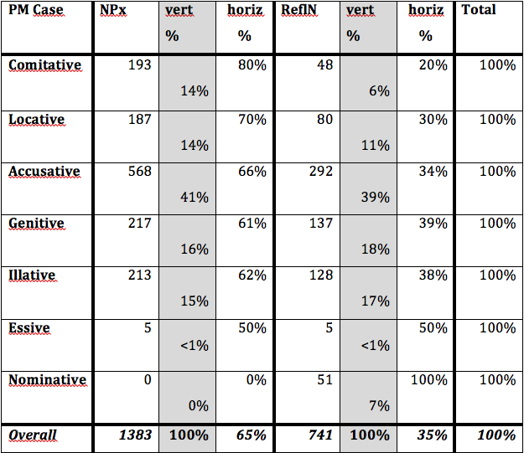
The Case of the Possessum
ReflN is well represented across the spectrum of cases, and predominates in Nominative, where NPx is rare.
Greater syntactic flexibility of ReflN probably gives it a competitive advantage.

Slide 51
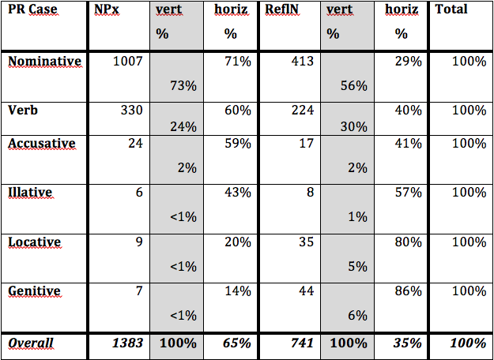
The Case of the Possessor
ReflN prevails in the Locative and Genitive cases, which are peripheral for possessors.
Peripheral uses are more vulnerable to linguistic change.

Slide 52
The Case of the Possessor
For both PMCase and PRCase, ReflN is robustly attested across the spectrum of syntactic environments.
ReflN is actually preferred precisely in the syntactic environments that are most atypical for the expression of possession, making ReflN the construction of choice in the environments that are likely to be most influential in language change.
ReflN prevails in the Locative and Genitive cases, which are peripheral for possessors.
Peripheral uses are more vulnerable to linguistic change.

Slide 53
What about frequency?
It is often the case that high frequent lexemes are more resistant to language change
Given the nature of our longitudinal data (mostly gathered by hand from books), it is not possible to measure the frequencies of lexemes in that data
However, it is possible to measure frequencies in the newspaper data
Newspapers: 10M words from three newspapers (1997-2011)
29,964 examples of words with frequency ≥5, partial automatic analysis, a lot of cleaning by hand

Slide 54
Distribution of possessive constructions
Distribution of possessive constructions in newspaper data is similar to Young generation

Slide 55
No evidence that frequency helps retain NPx
News data
Pearson's correlation = -0.14
p = 0.0001
95% confidence interval:
-0.2 -0.07

Slide 56
NPx > ReflN Change
North Saami sociolinguistics
contact pressure from Norwegian, Swedish, and Finnish
suppressed through discriminatory policies in mid 20th century
When a language is under pressure, morphology tends to simplify
North Saami has two possessive constructions
NPx = Noun + Possessive suffix, high morphological complexity
ReflN = Genitive Reflexive Pronoun + Noun, compositional without added complexity
Simpler ReflN replaces NPx simultaneous with policies that removed Mid Generation speakers from L1 environment during their school years

Slide 57
NPx > ReflN Change
It is likely that this linguistic change was catalyzed by discriminatory policy
North Saami sociolinguistics
contact pressure from Norwegian, Swedish, and Finnish
suppressed through discriminatory policies in mid 20th century
When a language is under pressure, morphology tends to simplify
North Saami has two possessive constructions
NPx = Noun + Possessive suffix, high morphological complexity
ReflN = Genitive Reflexive Pronoun + Noun, compositional without added complexity
Simpler ReflN replaces NPx simultaneous with policies that removed Mid Generation speakers from L1 environment during their school years

Slide 58
NPx > ReflN Change
Frequency does not play a role
ReflN is well represented across the semantic spectrum, with particular strength precisely where possession is less typical, namely with abstract nouns.
ReflN is particularly strong precisely in syntactic situations that are unusual for possession.
Syntax, semantics, morphological complexity in a heterogeneous sociolinguistic situation, geographic, and pragmatic tendencies seem to have aligned in North Saami to promote ReflN

Slide 59
Challenges
Documentation of North Saami is in Norwegian, Swedish, and Finnish
No opportunity for an intensive or immersion experience
No knowledge of reindeer herding
How to reach the English-speaking audience

